Slide 1
Chapter 23: Fabric Technologies
Instructor Materials
CCNP Enterprise: Core Networking

Slide 2
Chapter 23 Content
This chapter covers the following content:
Software-Defined Access (SD-Access) - This section defines the benefits of SD-Access over traditional campus networks as well as the components and features of the Cisco SD-Access solution, including the nodes, fabric control plane, and data plane.
Software-Defined WAN (SD-WAN) - This section defines the benefits of SD-WAN over traditional WANs as well as the components and features of the Cisco SD-WAN solution, including the orchestration plane, management plane, control plane, and data plane.

Slide 3
Software-Defined Access (SD-Access)
A fabric network is an overlay network (virtual network) built over an underlay network (physical network) using overlay tunneling technologies such as VXLAN. Fabric networks improve upon traditional physical networks by enabling host mobility, network automation, network virtualization, and segmentation. They are more manageable, flexible, secure (by means of encryption), and scalable than traditional networks.
Manual network configuration changes are slow and can lead to misconfigurations that cause service disruptions on the network. The situation is exacerbated in a constantly changing environment where more users, endpoints, and applications are being added.
The increase in users and endpoints makes configuring user credentials and maintaining a consistent policy across the network very complex.

Slide 4
Software-Defined Access (SD-Access) SD Access Features
With SD-Access, an evolved campus network can be built that addresses the needs of existing campus networks by leveraging the following capabilities, features, and functionalities:
Network automation - SD-Access replaces manual network device configurations with network device management through a single point of automation, orchestration, and management of network functions through the use of Cisco DNA Center.
Network assurance and analytics - SD-Access enables proactive prediction of network-related and security-related risks by using telemetry to improve the performance of the network, endpoints, and applications, including encrypted traffic.
Host mobility - SD-Access provides host mobility for both wired and wireless clients.
Identity services - Cisco Identity Services Engine (ISE) identifies users and devices connecting to the network and provides the contextual information required for users and devices to implement security policies for network access control and network segmentation.

Slide 5
Software-Defined Access (SD-Access) SD Access Features (Cont.)
Policy enforcement - Traditional access control lists (ACLs) can be difficult to deploy, maintain, and scale because they rely on IP addresses and subnets. Creating access and application policies based on group-based policies using Security Group Access Control Lists (SGACLs) provides a much simpler and more scalable form of policy enforcement based on identity instead of an IP address.
Secure segmentation - With SD-Access it is easier to segment the network to support guest, corporate, facilities, and IoT-enabled infrastructure.
Network virtualization - SD-Access makes it possible to leverage a single physical infrastructure to support multiple virtual routing and forwarding (VRF) instances, referred to as virtual networks (VNs), each with a distinct set of access policies.

Slide 6
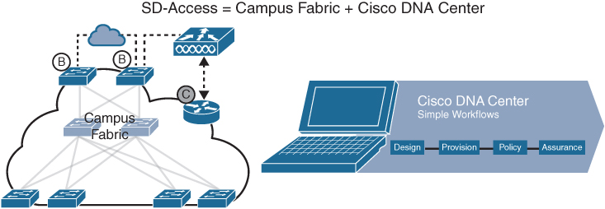
Software-Defined Access (SD-Access) What is SD Access?
SD-Access has two main components:
Cisco Campus fabric solution - The campus fabric is a Cisco-validated fabric overlay solution that includes all of the features and protocols (control plane, data plane, management plane, and policy plane) to operate the network infrastructure.
Cisco DNA Center - When the campus fabric solution is managed via the Cisco DNA Center, the solution is considered to be SD-Access, as illustrated in Figure 23-1.
Figure 23-1 SD-Access Solution

Slide 7
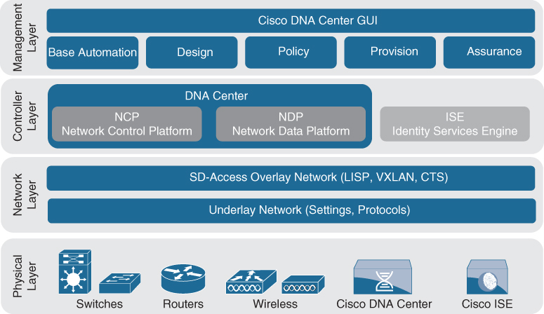
Software-Defined Access (SD-Access) What is SD Access Architecture
Cisco SD-Access is based on existing hardware and software technologies. What makes Cisco SD-Access special is how these technologies are integrated and managed together. The Cisco SD-Access fabric architecture can be divided into four basic layers, as illustrated in Figure 23-2.
Figure 23-2 Cisco SD-Access Architecture

Slide 8
Software-Defined Access (SD-Access) Physical Layer
While Cisco SD-Access is designed for user simplicity, abstraction, and virtual environments, everything runs on top of physical network devices (switches, routers, servers, wireless LAN controllers (WLCs), and wireless access points (APs). Cisco access layer switches that do not actively participate in the SD-Access fabric but that are part of it because of automation are referred to as SD-Access extension nodes.
The following are the physical layer devices of the SD-WAN fabric:
Cisco switches - Switches provide wired (LAN) access to the fabric. Multiple types of Cisco Catalyst switches are supported, as well as Nexus switches.
Cisco routers - Routers provide WAN and branch access to the fabric. Multiple types of Cisco ASR 1000, ISR, and CSR routers, including the CSRv and ISRv cloud routers, are supported.
Cisco wireless - Cisco WLCs and APs provide wireless (WLAN) access to the fabric.
Cisco controller appliances - Cisco DNA Center and Cisco ISE are the two controller appliances required.

Slide 9
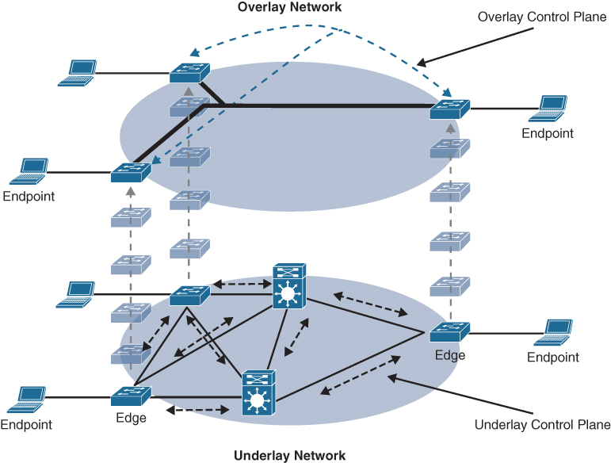
Software-Defined Access (SD-Access) Network Layer
The network layer consists of the underlay network and the overlay network. These two sublayers work together to deliver data packets to and from the network devices participating in SD-Access. All this network layer information is made available to the controller layer.
The network underlay is the underlying physical layer, and its sole purpose is to transport data packets between network devices for the SD-Access fabric overlay.
The overlay network is a virtual (tunneled) network that virtually interconnects all of the network devices forming a fabric of interconnected nodes. It abstracts the inherent complexities and limitations of the underlay network.
Figure 23-3 Underlay and Overlay Networks
Figure 23-3 shows a visual representation of the relationship between an overlay network and the network underlay.

Slide 10
Software-Defined Access (SD-Access) Underlay Network
Two models of underlay that are supported are as follows:
Manual underlay - This type of underlay network is configured and managed manually (such as with a CLI or an API) rather than through Cisco DNA Center. An advantage of the manual underlay is that it allows customization of the network to fit any special design requirements (such as changing the IGP to OSPF). It allows SD-Access to run on the top of a legacy (or third-party) IP-based network.
Automated underlay - In a fully automated network underlay, all aspects of the underlay network are configured and managed by the Cisco DNA Center LAN Automation feature. The LAN Automation feature creates an IS-IS routed access campus design. It uses the Cisco Network Plug and Play features to deploy both unicast and multicast routing configuration in the underlay to improve traffic delivery efficiency for SD-Access. An automated underlay eliminates misconfigurations and reduces the complexity of the network underlay. It also greatly simplifies and speeds the building of the network underlay. A downside to an automated underlay is that it does not allow manual customization for special design requirements.

Slide 11
Software-Defined Access (SD-Access) Overlay Network (SD-Access Fabric)
The SD-Access fabric is the overlay network, and it provides policy-based network segmentation, host mobility for wired and wireless hosts, and enhanced security beyond the normal switching and routing capabilities of a traditional network.
In SD-Access, the fabric overlay is fully automated, regardless of the underlay network model used (manual or automated). It includes all necessary overlay control plane protocols and addressing, as well as all global configurations associated with operation of the SD-Access fabric.
There are three basic planes of operation in the SD-Access fabric:
Control plane, based on Locator/ID Separation Protocol (LISP)
Data plane, based on Virtual Extensible LAN (VXLAN)
Policy plane, based on Cisco TrustSec

Slide 12
Software-Defined Access (SD-Access) SD-Access Control Plane
The SD-Access fabric control plane is based on Locator/ID Separation Protocol (LISP).
LISP is an IETF standard protocol defined in RFC 6830 that is based on a simple endpoint ID (EID) to routing locator (RLOC) mapping system to separate the identity (endpoint IP address) from its current location (network edge/border router IP address).
LISP dramatically simplifies traditional routing environments by eliminating the need for each router to process every possible IP destination address and route. It does this by moving remote destination information to a centralized mapping database called the LISP map server (MS) (a control plane node in SD-Access), which allows each router to manage only its local routes and query the map system to locate destination EIDs.
This technology provides many advantages for Cisco SD-Access, such as smaller routing tables, dynamic host mobility for wired and wireless endpoints, address-agnostic mapping (IPv4, IPv6, and/ or MAC), and built-in network segmentation through VRF instances.

Slide 13
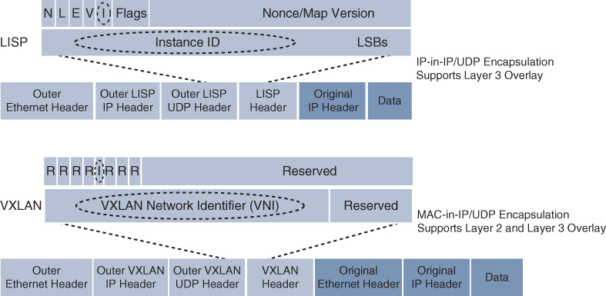
Software-Defined Access (SD-Access) SD-Access Fabric Data Plane
SD-Access Fabric Data Plane The tunneling technology used for the fabric data plane is based on Virtual Extensible LAN (VXLAN). VXLAN encapsulation is IP/UDP based, meaning that it can be forwarded by any IP-based network (legacy or third party) and creates the overlay network for the SD-Access fabric. Although LISP is the control plane for the SD-Access fabric, it does not use LISP data encapsulation for the data plane.
The differences between the LISP and VXLAN packet formats are illustrated in Figure 23-4.
Figure 23-4 LISP and VXLAN Packet Format Comparison

Slide 14
Software-Defined Access (SD-Access) SD-Access Fabric Plane (Cont.)
The original VXLAN specification was enhanced for SD-Access to support Cisco TrustSec Scalable Group Tags (SGTs). This added new fields to the first 4 bytes of the VXLAN header in order to transport up to 64,000 SGT tags. The new VXLAN format is called VXLAN Group Policy Option (VXLAN-GPO), and it is defined in the IETF draft draft-smith-vxlan-group-policy-05. The new fields in the VXLAN-GPO packet format include the following:
Group Policy ID - 16-bit identifier that is used to carry the SGT tag.
Group Based Policy Extension Bit (G Bit) - 1-bit field that, when set to 1, indicates an SGT tag is being carried within the Group Policy ID field and is set to 0 when it is not.
Don’t Learn Bit (D Bit) - 1-bit field that when set to 1 indicates that the egress virtual tunnel endpoint (VTEP) must not learn the source address of the encapsulated frame.
Policy Applied Bit (A Bit) - 1-bit field that is only defined as the A bit when the G bit field is set to 1. When the A bit is set to 1, it indicates that the group policy has already been applied to this packet, and further policies must not be applied by network devices. When it is set to 0, group policies must be applied by network devices, and they must set the A bit to 1 after the policy has been applied.

Slide 15
Software-Defined Access (SD-Access) SD-Access Fabric Policy Plane
The fabric policy plane is based on Cisco TrustSec. Cisco TrustSec SGT tags are assigned to authenticated groups of users or end devices. Network policy (for example, ACLs, QoS) is then applied throughout the SD-Access fabric, based on the SGT tag instead of a network address (MAC, IPv4, or IPv6).
TrustSec SGT tags provide several advantages for Cisco SD-Access, such as:
Support for both network-based segmentation using VNs (VRF instances) and group-based segmentation (policies)
Network address-independent group-based policies based on SGT tags rather than MAC, IPv4, or IPv6 addresses, which reduces complexity
Dynamic enforcement of group-based policies, regardless of location for both wired and wireless traffic
Policy constructs over a legacy or third-party network using VXLAN
Extended policy enforcement to external networks (such as cloud or data center networks) by transporting the tags to Cisco TrustSec-aware devices using SGT Exchange Protocol (SXP)

Slide 16
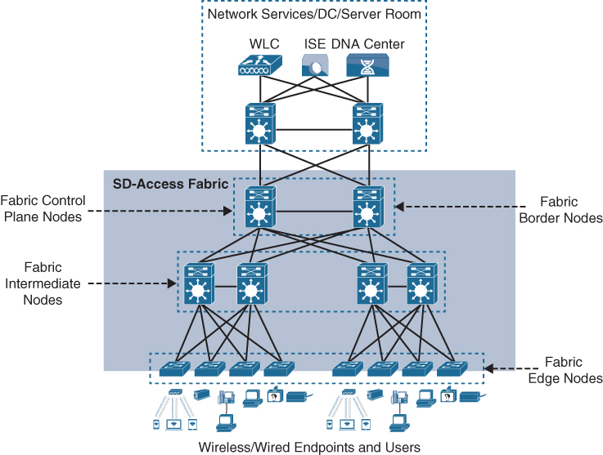
Software-Defined Access (SD-Access) SD-Access Fabric Roles and Components
The operation of the SD-Access fabric requires multiple different device roles, each with a specific set of responsibilities. Each SD-Access-enabled network device must be configured for one (or more) of the five basic device roles in the fabric overlay:
Control plane node
Fabric border node
Fabric edge node
Fabric WLAN controller (WLC)
Intermediate nodes
Figure 23-6 SD-Access Fabric Roles
Figure 23-6 illustrates the different SD-Access fabric design roles and how nodes in the fabric can play multiple roles. For example, the core layer routers in this figure are acting as fabric border nodes and control plane nodes.

Slide 17
Software-Defined Access (SD-Access) Fabric Edge Nodes
A fabric edge node provides onboarding and mobility services for wired users and devices (including fabric-enabled WLCs and APs) connected to the fabric. It is a LISP tunnel router (xTR) that also provides the anycast gateway, endpoint authentication, and assignment to overlay host pools (static or DHCP), as well as group-based policy enforcement (for traffic to fabric endpoints).
A fabric edge first identifies and authenticates wired endpoints (through 802.1x), in order to place them in a host pool (SVI and VRF instance) and scalable group (SGT assignment). It then registers the specific EID host address (that is, MAC, /32 IPv4, or /128 IPv6) with the control plane node.
A fabric edge provides a single Layer 3 anycast gateway (that is, the same SVI with the same IP address on all fabric edge nodes) for its connected endpoints and also performs the encapsulation and de-encapsulation of host traffic to and from its connected endpoints.
An edge node must be either a Cisco switch or router operating in the fabric overlay.

Slide 18
Software-Defined Access (SD-Access) Fabric Control Plane Nodes
A fabric control plane node is a LISP map server/resolver (MS/MR) with enhanced functions for SD-Access, such as fabric wireless and SGT mapping. It maintains a simple host tracking database to map EIDs to RLOCs.
The control plane (host database) maps all EID locations to the current fabric edge or border node, and it is capable of multiple EID lookup types (IPv4, IPv6, or MAC).
The control plane receives registrations from fabric edge or border nodes for known EID prefixes from wired endpoints and from fabric mode WLCs for wireless clients. It also resolves lookup requests from fabric edge or border nodes to locate destination EIDs and updates fabric edge nodes and border nodes with wired and wireless client mobility and RLOC information.
Control plane devices must maintain all endpoint (host) mappings in a fabric. A device with sufficient hardware and software scale for the fabric must be selected for this function.

Slide 19
Software-Defined Access (SD-Access) Fabric Border Nodes
Fabric border nodes are LISP proxy tunnel routers (PxTRs) that connect external Layer 3 networks to the SD-Access fabric and translate reachability and policy information, such as VRF and SGT information, from one domain to another.
There are three types of border nodes:
Internal border (rest of company) - Connects only to the known areas of the organization (for example, WLC, firewall, data center).
Default border (outside) - Connects only to unknown areas outside the organization. This border node is configured with a default route to reach external unknown networks such as the internet or the public cloud that are not known to the control plane nodes.
Internal + default border (anywhere) - Connects transit areas as well as known areas of the company. This is basically a border that combines internal and default border functionality into a single node.

Slide 20
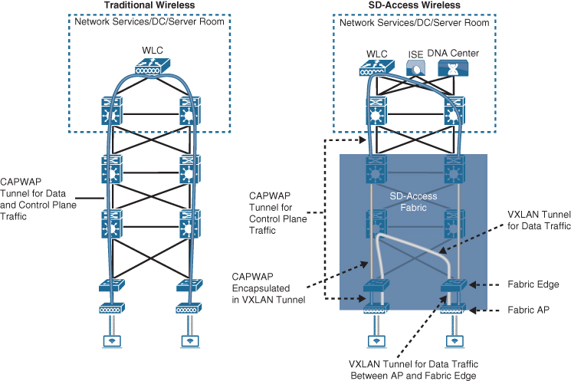
Software-Defined Access (SD-Access) Fabric Wireless Controller (WLC)
A fabric-enabled WLC connects APs and wireless endpoints to the SD-Access fabric. The WLC is external to the fabric and connects to the SD-Access fabric through an internal border node.
In traditional wireless deployments, the WLC is typically centralized, and all control plane and data plane (wireless client data) traffic needs to be tunneled to the WLC through the Control and Provisioning of Wireless Access Points (CAPWAP) tunnel.
In SD-Access, the wireless control plane remains centralized, but the data plane is distributed using VXLAN directly from the fabric-enabled APs.
Figure 23-7 Traditional Wireless and SD-Access Wireless Deployments
Figure 23-7 illustrates a traditional wireless deployment compared to an SD-Access wireless deployment.

Slide 21
Software-Defined Access (SD-Access) SD-Access Fabric Concepts
Better understanding the benefits and operation of Cisco SD-Access requires reviewing the following concepts related to how the multiple technologies that are used by the SD-WAN solution operate and interact in SD-Access:
Virtual network (VN) - The VN provides virtualization at the device level, using VRF instances to create multiple Layer 3 routing tables. VRF instances provide segmentation across IP addresses, allowing for overlapped address space and traffic segmentation.
Host pool - A host pool is a group of endpoints assigned to an IP pool subnet in the SDA-Access fabric. Fabric edge nodes have a Switched Virtual Interface (SVI) for each host pool to be used by endpoints and users as their default gateway.
Scalable group - A scalable group is a group of endpoints with similar policies. The SD-Access policy plane assigns every endpoint (host) to a scalable group using TrustSec SGT tags. Assignment to a scalable group can be either static per fabric edge port or using dynamic authentication through AAA or RADIUS using Cisco ISE.
Anycast gateway - The anycast gateway provides a pervasive Layer 3 default gateway where the same SVI is provisioned on every edge node with the same SVI IP and MAC address. This allows an IP subnet to be stretched across the SD-Access fabric.

Slide 22
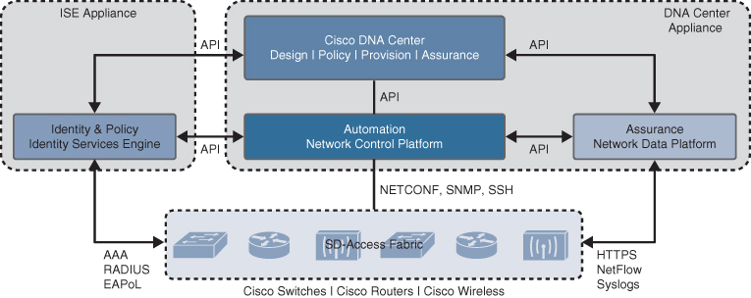
Software-Defined Access (SD-Access) Controller Layer
The controller layer provides all of the management subsystems for the management layer, and this is all provided by Cisco DNA Center and Cisco ISE. Figure 23-8 illustrates the different components that comprise the controller layer and how they interact with each other as well as with the campus fabric.
Figure 23-8 SD-Access Main Components

Slide 23
Software-Defined Access (SD-Access) Controller Layer Subsystems
There are three main controller subsystems:
Cisco Network Control Platform (NCP) - This is a subsystem integrated directly into Cisco DNA Center that provides all the underlay and fabric automation and orchestration services for the physical and network layers. NCP configures and manages Cisco network devices and then provides network automation status and other information to the management layer.
Cisco Network Data Platform (NDP) - NDP is a data collection and analytics and assurance subsystem that is integrated directly into Cisco DNA Center. NDP analyzes and correlates various network events through multiple sources (such as NetFlow and Switched Port Analyzer [SPAN]) and identifies historical trends.
Cisco Identity Services Engine (ISE) - The basic role of ISE is to provide all the identity and policy services for the physical layer and network layer. ISE provides network access control (NAC) and identity services for dynamic endpoint-to-group mapping and policy definition in a variety of ways.

Slide 24
Software-Defined Access (SD-Access) Management Layer
The Cisco DNA Center management layer is the user interface/user experience (UI/UX) layer, where all the information from the other layers is presented to the user in the form of a centralized management dashboard. It is the intent-based networking aspect of Cisco DNA.
The Cisco DNA design workflow provides all the tools needed to logically define the SD-Access fabric. The following are some of the Cisco DNA design tools:
Network Hierarchy - Used to set up geolocation, building, and floorplan details and associate them with a unique site ID.
Network Settings - Used to set up network servers (such as DNS, DHCP, and AAA), device credentials, IP management, and wireless settings.
Image Repository - Used to manage the software images and/or maintenance updates, set version compliance, and download and deploy images.
Network Profiles - Used to define LAN, WAN, and WLAN connection profiles (such as SSID) and apply them to one or more sites.

Slide 25
Software-Defined Access (SD-Access) Cisco DNA Policy Workflow
The Cisco DNA policy workflow provides all the tools to logically define Cisco DNA policies. The following are some of the Cisco DNA policy tools:
Dashboard - Used to monitor all the VNs, scalable groups, policies, and recent changes.
Group-Based Access Control - Used to create group-based access control policies, which are the same as SGACLs. Cisco DNA Center integrates with Cisco ISE to simplify the process of creating and maintaining SGACLs.
IP-Based Access Control - Used to create IP-based access control policy to control the traffic going into and coming out of a Cisco device in the same way that an ACL does.
Application - Used to configure QoS in the network through application policies.
Traffic Copy - Used to configure Encapsulated Remote Switched Port Analyzer (ERSPAN) to copy the IP traffic flow between two entities to a specified remote destination for monitoring or troubleshooting purposes.
Virtual Network - Used to set up the virtual networks (or use the default VN) and associate various scalable groups

Slide 26
Software-Defined Access (SD-Access) Cisco DNA Provision Workflow
The Cisco DNA provision workflow provides all the tools to deploy the Cisco SD-Access fabric. The following are some of the Cisco DNA provision tools:
Devices - Used to assign devices to a site ID, confirm or update the software version, and provision the network underlay configurations.
Fabrics - Used to set up the fabric domains (or use the default LAN fabric).
Fabric Devices - Used to add devices to the fabric domain and specify device roles (such as control plane, border, edge, and WLC).
Host Onboarding - Used to define the host authentication type (static or dynamic) and assign host pools (wired and wireless) to various VNs.

Slide 27
Software-Defined WAN (SD-WAN)
Managing enterprise networks is becoming more complex, with customers embracing a multicloud approach, applications moving to the cloud, mobile and IoT devices growing exponentially in the network, and the internet edge moving to the branch. This digital transformation is powering the adoption of SD-WAN by customers looking to do the following:
Lower costs and reduce risks with simple WAN automation and orchestration.
Extend their enterprise networks (such as branch or on-premises) seamlessly into the public cloud.
Provide optimal user experience for SaaS applications.
Leverage a transport-independent WAN for lower cost and higher diversity. This means the underlay network can be any type of IP-based network, such as the internet, MPLS, 3G/4G LTE, satellite, or dedicated circuits.
Enhance application visibility and use that visibility to improve performance with intelligent path control to meet SLAs for business-critical and real-time applications.
Provide end-to-end WAN traffic segmentation and encryption for protecting critical enterprise compute resources.

Slide 28
Software-Defined WAN (SD-WAN) SD-WAN Solutions
Cisco currently offers two SD-WAN solutions:
Cisco SD-WAN (based on Viptela) - This is the preferred solution for organizations that require an SD-WAN solution with cloud-based initiatives that provides granular segmentation, advanced routing, advanced security, and complex topologies while connecting to cloud instances.
Meraki SD-WAN - This is the recommended solution for organizations that require unified threat management (UTM) solutions with SD-WAN functionality or that are existing Cisco Meraki customers looking to expand to SD-WAN. UTM is an all-in-one security solution delivered in a single appliance and typically includes the following security features: firewall, VPN, intrusion prevention, antivirus, antispam, and web content filtering.

Slide 29
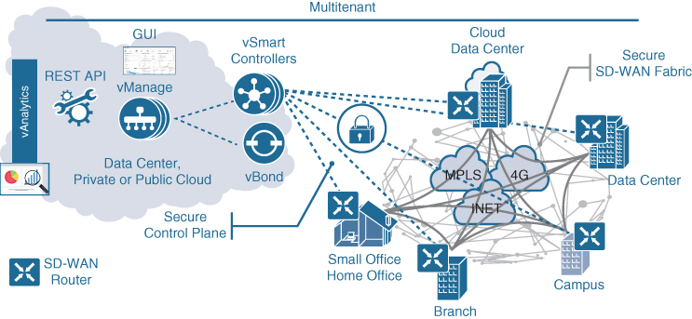
Software-Defined WAN (SD-WAN) Cisco SD-WAN Architecture
Cisco SD-WAN (based on Viptela) is a cloud-delivered overlay WAN architecture that facilitates digital and cloud transformation for enterprises. It addresses all the customer requirements mentioned earlier. Figure 23-13 shows how SD-WAN can be used to provide secure connectivity to remote offices, branch offices, campus networks, data centers, and the cloud over any type of IP-based underlay transport network, such as the internet, 3G/4G LTE, and MPLS. It also illustrates how some of the components to manage the SD-WAN fabric can be deployed on a data center, private cloud, or public cloud.
Figure 23-13 SD-WAN Solution Architecture

Slide 30
Software-Defined WAN (SD-WAN) Cisco SD-WAN Solution
The Cisco SD-WAN solution has four main components and an optional analytics service:
vManage NMS - The vManage NMS is a single pane of glass network management system (NMS) GUI that is used to configure and manage the full SD-WAN solution. It enables centralized provisioning and simplifies network changes.
vSmart Controller - vSmart controllers have pre-installed credentials that allow them to authenticate every SD-WAN router that comes online. These credentials ensure that only authenticated devices are allowed access to the SD-WAN fabric. After successful authentication, each vSmart controller establishes a permanent DTLS tunnel to each SD-WAN router in the SD-WAN fabric and uses these tunnels to establish Overlay Management Protocol (OMP) neighbor relationships with each SD-WAN router. OMP is a proprietary routing protocol similar to BGP that can advertise routes, next hops, keys, and policy information needed to establish and maintain the SD-WAN fabric.

Slide 31
Software-Defined WAN (SD-WAN) Cisco SD-WAN Solution (Cont.)
Cisco SD-WAN Routers (vEdge and cEdge): Cisco SD-WAN routers deliver the essential WAN, security, and multicloud capabilities of the Cisco SD-WAN solution. They are available as hardware, software, cloud, or virtualized routers that sit at the perimeter of a site, such as a remote office, branch office, campus, or data center. SD-WAN routers support standard router features, such as OSPF, BGP, ACLs, QoS, and routing policies, in addition to the SD-WAN overlay control and data plane functions.
There are two different SD-WAN router options available for the Cisco SD-WAN solution:
vEdge: The original Viptela platforms running Viptela software.
cEdge: Viptela software integrated with Cisco IOS-XE. This is supported on CSR, ISR, ASR1K, ENCS, and the cloud-enabled CSRv and ISRv platforms.

Slide 32
Software-Defined WAN (SD-WAN) Cisco SD-WAN Solution (Cont.)
A main differentiator between SD-WAN cEdge routers and vEdge routers is that cEdge routers support advanced security features, as demonstrated in Table 23-2.
Table 23-2 SD-WAN Router Advanced Security Feature Comparison
Feature | cEdge | vEdge
Cisco AMP and AMP Threat Grid | Yes | No
Enterprise Firewall | Yes | Yes
Cisco Umbrella DNS Security | Yes | Yes
URL filtering | Yes | No
The Snort intrusion prevention system (IPS) | Yes | No
Embedded platform security (including the Cisco Trust Anchor module) | Yes | No

Slide 33
Software-Defined WAN (SD-WAN) vBond Orchestrator
The vBond orchestrator authenticates the vSmart controllers and the SD-WAN routers and orchestrates connectivity between them. It is the only device that must have a public IP address so that all SD-WAN devices in the network can connect to it. A vBond orchestrator is an SD-WAN router that only performs vBond orchestrator functions.
The major components of the vBond orchestrator are:
Control plane connection - Each vBond orchestrator has a permanent control plane connection over a DTLS tunnel with each vSmart controller.
NAT traversal - The vBond orchestrator facilitates the initial orchestration between SD-WAN routers and vSmart controllers when one or both of them are behind NAT devices.
Load balancing - In a domain with multiple vSmart controllers, the vBond orchestrator automatically performs load balancing of SD-WAN routers across the vSmart controllers when routers come online.

Slide 34
Software-Defined WAN (SD-WAN) vAnalytics
vAnalytics is an optional analytics and assurance service that has many advanced capabilities, including the following:
Visibility into applications and infrastructure across the WAN
Forecasting and what-if analysis
Intelligent recommendations
These capabilities benefit SD-WAN in ways that are not possible without v Analytics. For example, if a branch office is experiencing latency or loss on its MPLS link, vAnalytics detects it and compare that latency or loss with information on other organizations in the area that it is also monitoring to see if they are also having that same issue in their circuits. If they are, vAnalytics can then report the issue with confidence to the SPs. vAnalytics can also help predict how much bandwidth is truly required for any location. This aids in deciding whether a circuit can be downgraded to a lower bandwidth to reduce costs.

Slide 35
Software-Defined WAN (SD-WAN) Cisco SD-WAN Cloud OnRamp
Traditional enterprise WAN architectures are not designed for the cloud. As organizations adopt more SaaS applications such as Office 365 and public cloud infrastructures such as AWS and Microsoft Azure, the current network infrastructure poses major problems related to the level of complexity and end-user experience. The Cisco SD-WAN solution includes a set of functionalities addressing optimal cloud SaaS application access and IaaS connectivity, called Cloud OnRamp.
Cloud OnRamp delivers the best application quality of experience (QoE) for SaaS applications by continuously monitoring SaaS performance across diverse paths and selecting the best-performing path based on performance metrics (jitter, loss, and delay). In addition, it simplifies hybrid cloud and multicloud IaaS connectivity by extending the SD-WAN fabric to the public cloud while at the same time increasing high availability and scale.

Slide 36
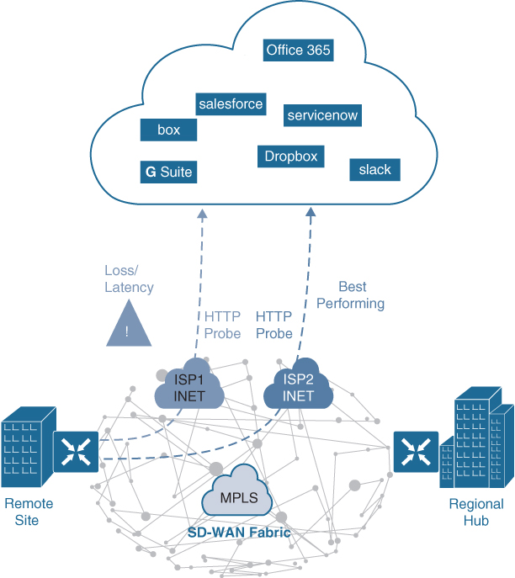
Software-Defined WAN (SD-WAN) Cloud OnRamp for SaaS
Figure 23-14 illustrates a remote site with dual direct internet access (DIA) circuits from two different internet service providers (ISP1 and ISP2).
When Cloud OnRamp for SaaS is configured for an SaaS application on vManage, the SD-WAN router at the remote site starts sending small HTTP probes to the SaaS application through both DIA circuits to measure latency and loss. Based on the results, the SD-WAN router will know which circuit is performing (in this case, ISP2) and sends the SaaS application traffic out that circuit.
The process of probing continues, and if a change in performance characteristics of ISP2’s DIA circuit occurs, the remote site SD-WAN router makes an appropriate forwarding decision.
Figure 23-14 Cloud OnRamp for SaaS with Dual DIA

Slide 37

Software-Defined WAN (SD-WAN) Cloud OnRamp for SaaS (Cont.)
Figure 23-15 illustrates another example of Cloud OnRamp for SaaS. In this case, the remote site has a single DIA circuit to ISP1 and an SD-WAN fabric DTLS session to the regional hub.
Much as in the previous case, Cloud OnRamp for SaaS can be configured on the vManage NMS and become active on the remote site SD-WAN router. However, in this case, Cloud OnRamp for SaaS also gets enabled on the regional hub SD-WAN router and is designated as the gateway node. Quality probing service via HTTP toward the cloud SaaS application of interest starts on both the remote site SD-WAN and the regional hub SD-WAN.
Figure 23-15 Cloud OnRamp for SaaS DIA and Gateway

Slide 38
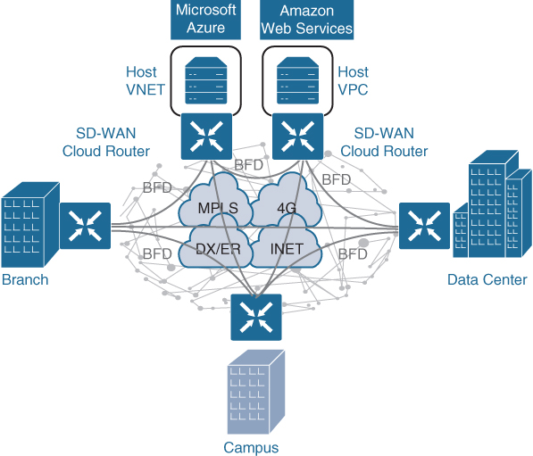
Software-Defined WAN (SD-WAN) Cloud OnRamp for IaaS
With the Cisco SD-WAN solution, ubiquitous connectivity, zero-trust security, end-to-end segmentation, and application-aware QoS policies can be extended into the IaaS environments by using SD-WAN cloud routers, as illustrated in Figure 23-16.
The transport-independent capability of the Cisco SD-WAN solution allows the use of a variety of connectivity methods by securely extending the SD-WAN fabric into the public cloud environment across any underlay transport network. These include the internet, MPLS, 3G/4G LTE, satellite, and dedicated circuits such as AWS’s DX and Microsoft Azure’s ER.
Figure 23-16 Cloud OnRamp for IaaS

Slide 39
Prepare for the Exam

Slide 40
Prepare for the Exam Key Topics for Chapter 23
Description
SD-Access capabilities, features, and functionalities
Cisco SD-Access architecture
Underlay network
Types of underlay networks supported by SD-Access
Overlay network (SD-Access fabric)
SD-Access basic planes of operation
SD-Access control plane description
SD-Access fabric data plane
VXLAN-GPO definition
SD-Access fabric policy plane

Slide 41
Prepare for the Exam Key Topics for Chapter 23 (Cont.)
Description
SD-Access fabric roles
Fabric edge nodes
Fabric control plane node
Fabric border nodes
Types of border nodes
Fabric wireless controller (WLC)
SD-Access fabric concepts
Controller layer
SD-Access three main controller subsystems
Management layer

Slide 42
Prepare for the Exam Key Topics for Chapter 23 (Cont.)
Description
SD-WAN main components
vManage NMS
vSmart controller
Cisco SD-WAN routers (vEdge and cEdge)
SD-WAN Router Advanced Security Feature Comparison
vBond orchestrator
SD-WAN Cloud OnRamp

Slide 43
Prepare for the Exam Key Terms for Chapter 23
Key Terms
802.1x | application programming interface (API)
Cisco Advanced Malware Protection (AMP) | Cisco Talos
Cisco Threat Grid | Cisco TrustSec
Cisco Umbrella | Datagram Transport Layer Security (DTLS)
egress tunnel router (ETR) | endpoint
endpoint identifier (EID) | host pool
ingress tunnel router (ITR) | LISP router
LISP site | Location/ID Separation Protocol (LISP)
MAC Authentication Bypass (MAB) | map resolver (MR)
map server (MS) | map server/map resolver (MS/MR)

Slide 44
Prepare for the Exam Key Terms for Chapter 23 (Cont.)
Key Terms
Network Configuration Protocol (NETCONF)/YANG | overlay network
proxy ETR (PETR) | proxy ITR (PITR)
proxy xTR (PxTR) | routing locator (RLOC)
Security Group Access Control List (SGACL) | scalable group tag
segment | segmentation
tunnel router (xTR) | underlay network
virtual network (VN) | virtual tunnel endpoint (VTEP)
VXLAN | VXLAN Group Policy Option (GPO)
VXLAN network identifier (VNI) | Web Authentication (WebAuth)

